Slide 1
SEB Healthcare Seminar
21 November, 2022
Anders Göransson, CEO

Slide 2
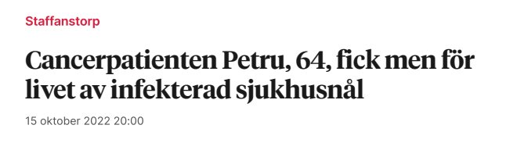
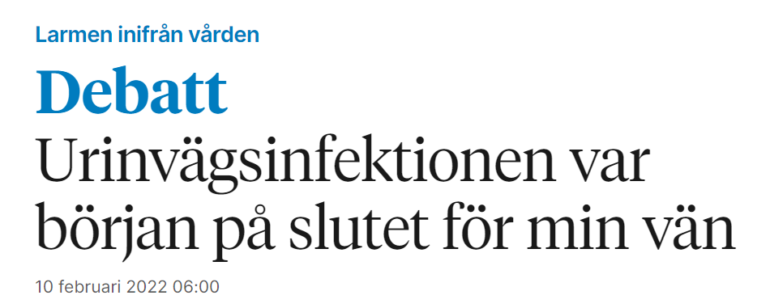
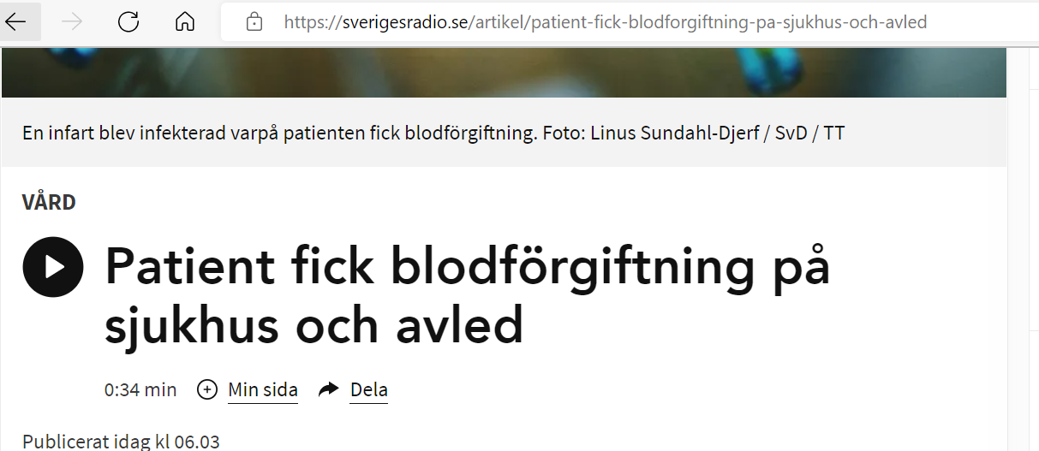
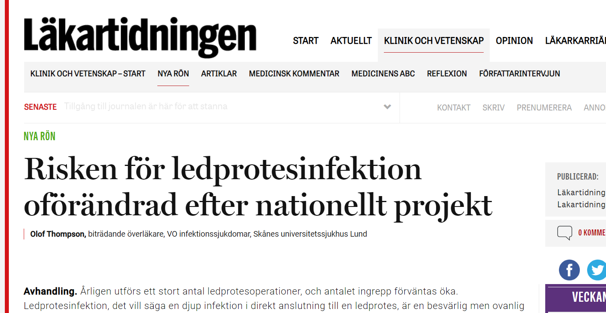
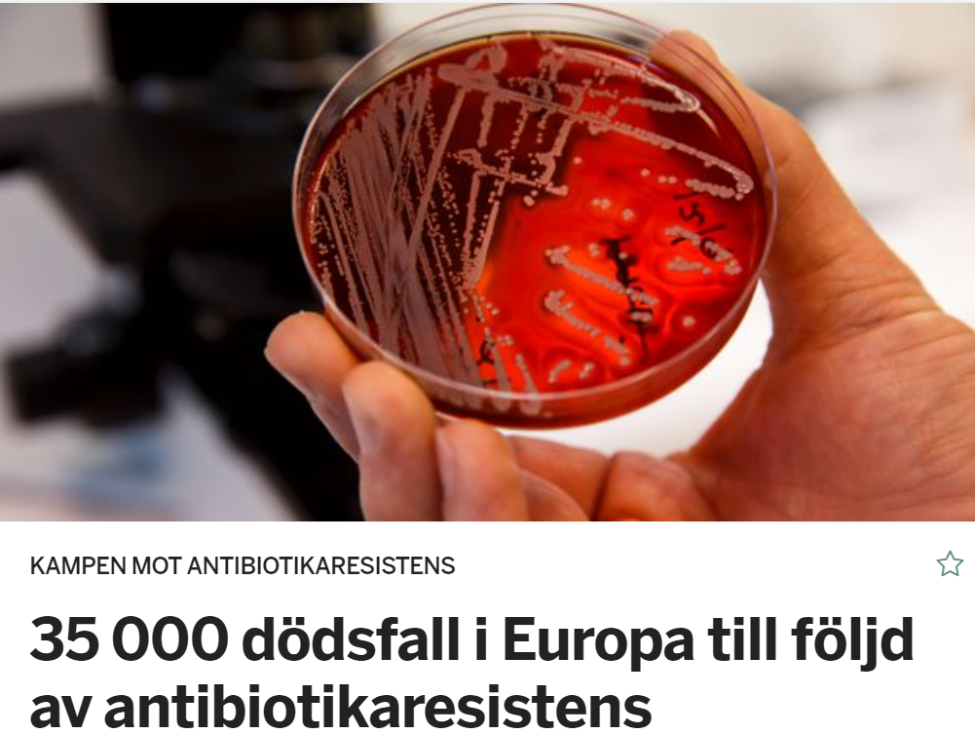
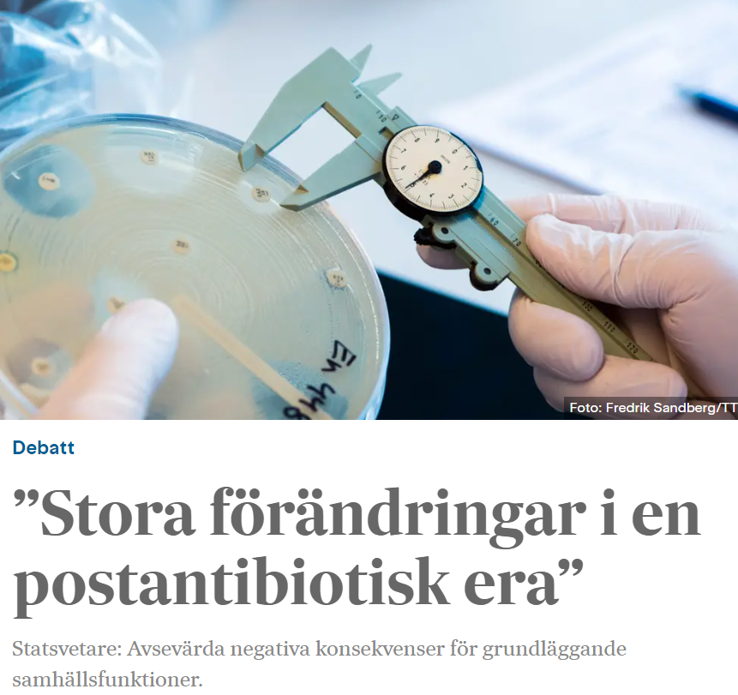

The need for infection prevention have never been greater
1 in every 10 patients worldwide affected by healthcare associated infections
Source: Various news articles from this year

Slide 3

Bactiguard’s vision:
Keeping people safe from infections

Slide 4

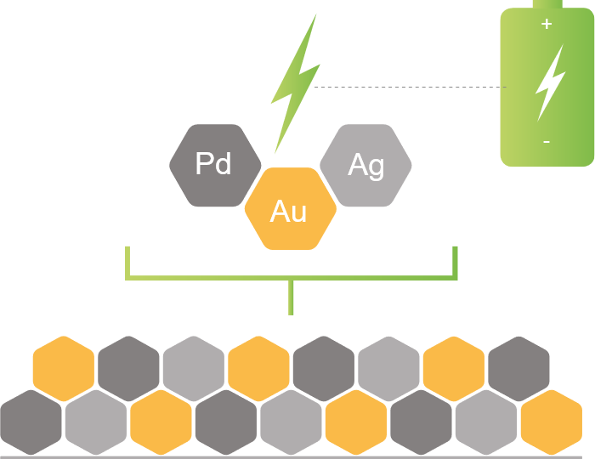



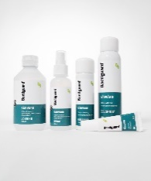




Bactiguard at a glance – setting a new standard for infection prevention
License agreements and proprietary product portfolio
Partnering with global market leaders
Unique technology for infection prevention
Expanding Wound and Animal care portfolio
Global coverage direct or via partners
45+ countries
Listed on Nasdaq Stockholm, Mid Cap segment
3 facilities in Malaysia and Sweden
Employees worldwide
~4 BSEK
~200
Production
capability

Slide 5
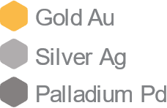
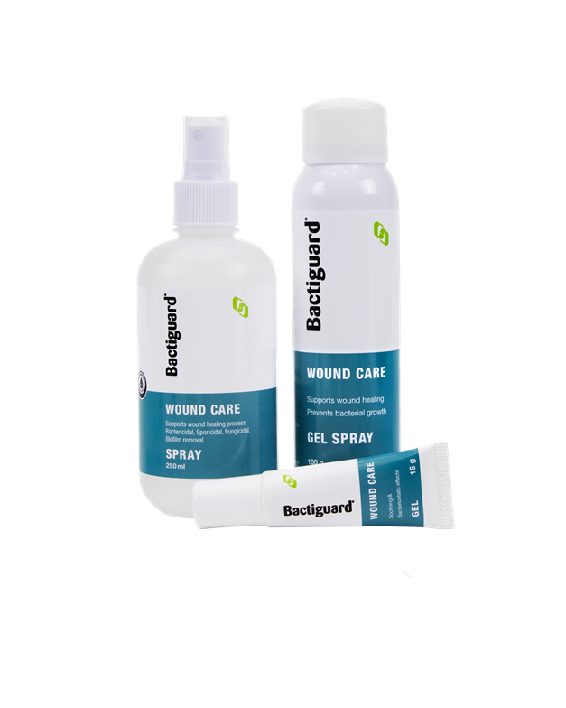
The Bactiguard® technology
Effective, safe and well protected
…
Coating of noble metals
Galvanic effect when in contact with fluids
Prevents microbial adhesion
(gram positive/negative bacteria and fungi)
Non-releasing and long lasting
Effective and safe
Strong IP protection
A portfolio of products based on hypochlorous acid (HOCl)
Same substance the body’s immune cells use to fight infections
Currently rolling out wound care, animal care and disinfection products
Notes:
Our unique technology for infection prevention is effective, safe and well protected.
It consists of a very thin coating of gold, palladium and silver – firmly attached to the surface of medical devices – which prevents bacteria and other microbes from colonizing on the surface and creating biofilm.
Imagine sticking your tongue on a battery (like this) or touching an electrial fence – it doesn’t kill you but it hurts and you will stay away from it. That’s exactly what happens to the the microbes – they stay away – even the most evil multi resitant bacteria or fungi.
As the coating is non-releasing it lasts longer and it is tissue friendly and safe for both short and long term use.
This is what makes us unique – there are other safe solutions and other effective solutions, but none that combine both.

Slide 6
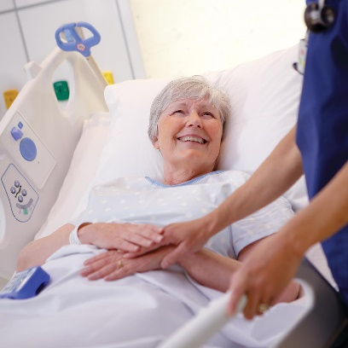
Patient focused strategy to leverage scalable business model
SCIENTIFIC EVIDENCE MANUFACTURING
REGULATORY TECHNOLOGY & IT
1
Orthopedics
LICENSE BUSINESS PRODUCT PORTFOLIO
2
Urology
3
Intravascular access /
Critical care
4
Dental
5
Wound management

Slide 7

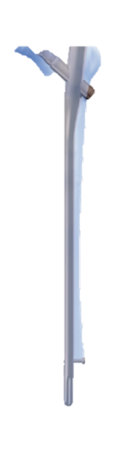


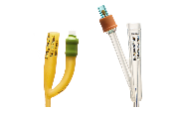


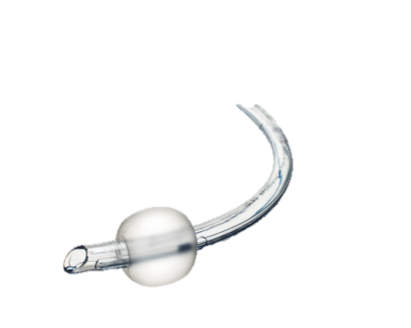

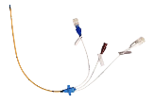



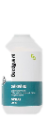

Strong foundation for expansion into large global markets
Therapeutic area
Own products
License partners
Market size, Billion USD
Orthopedics
Orthopedic implants
40
Urology
Urinary catheters
3
Intravascular / Critical care
18
CVC¹
ETT²
Dental
9
Wound management
Wound care
Surgical sutures
10
1 Central venous catheter
2. Entotrcheal tube
Source: GlobalData
Please note, numbers being further assessed
In Cardiovascular: SmartCella

Slide 8
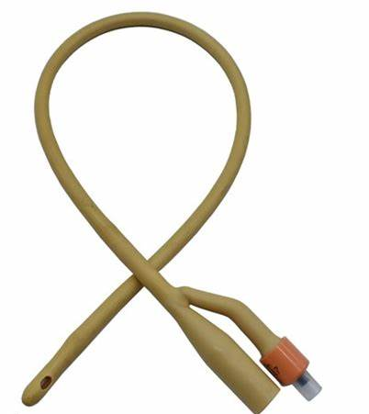
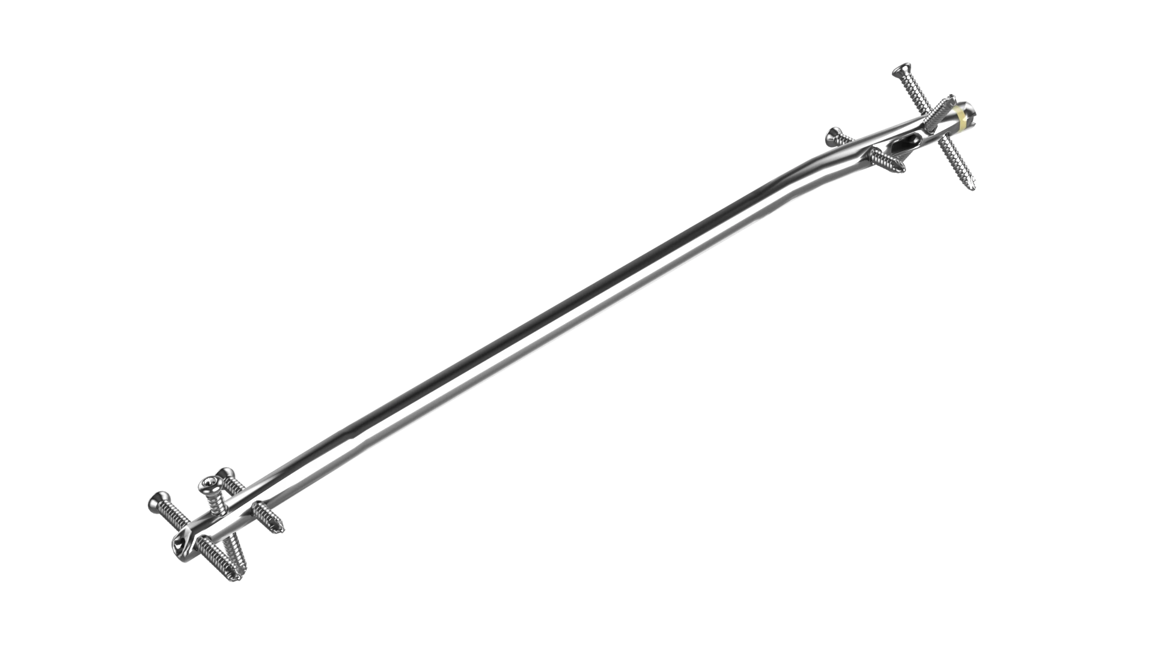


Two licence partners with products in the market
BD with IC (Infection Control) Urinary Catheters and ZB with ZNN Bactiguard Trauma nail
1990
1994
US
2019
2021
EMEA
Foley catheters
Trauma implants
Additional licence agreements signed with Smartwise in Sweden in 2017 and with Well Lead in China in 2018
Product launch

Slide 9
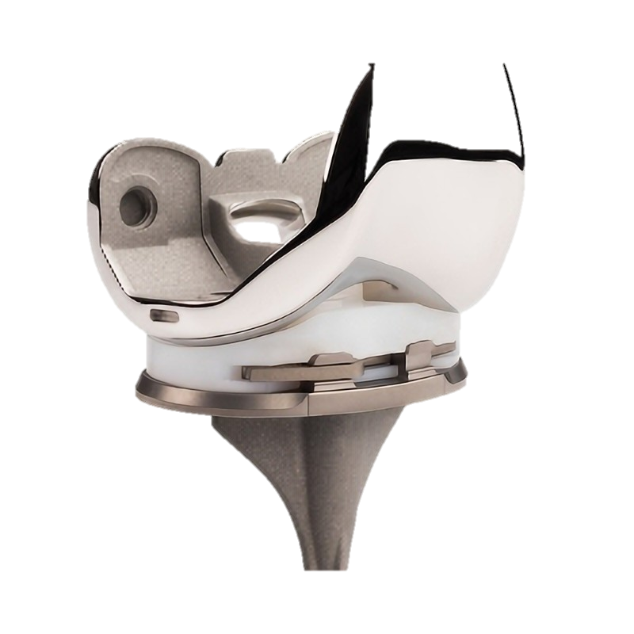
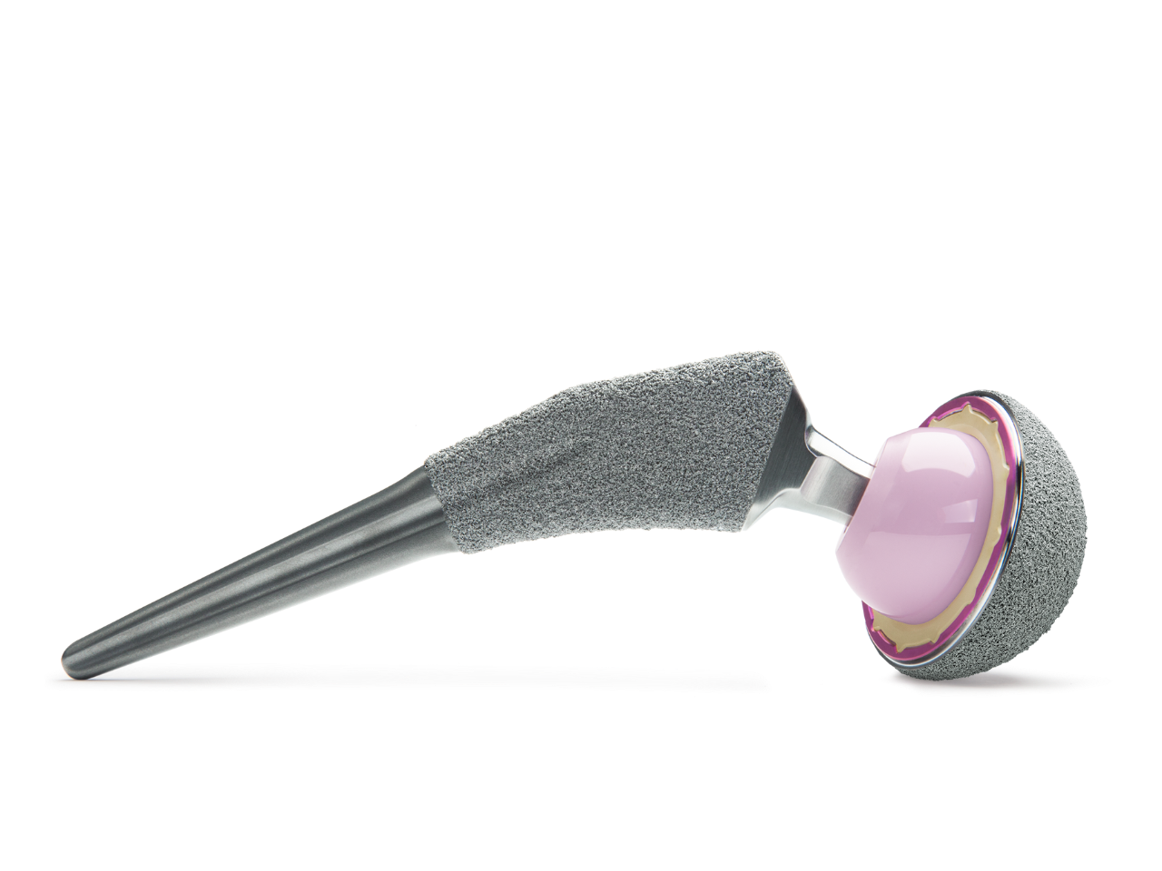

Significant acceleration in the licence portfolio
Significant work ongoing in the two recent agreements
1990
1994
US
2019
2021
EMEA
2022
Foley catheters
Trauma implants
Hips and knees replacements
Sports medicine
Craniomaxillofacial
Thorax applications
Dental
Additional licence agreements signed with Smartwise in Sweden in 2017 and with Well Lead in China in 2018
* Currently a global development partnership with a license option

Slide 10
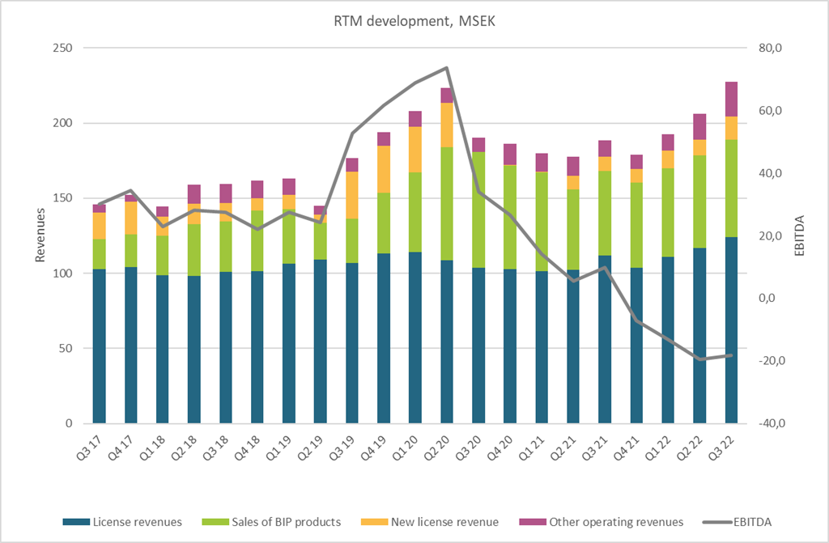
Bactiguard – third quarter 2022
Rolling 12-month revenue
Rolling 12-months revenue at all-time high
Strong recurring license revenue
  BD volume stable on a high level, growing business from Zimmer Biomet
Good momentum in New license revenue from ZB and Dentsply Sirona
BIP – Growing in focus markets
EBITDA impacted by planned investments in line with the focused growth strategy
  Q3 2022 positive
Notes:
Q3: Strong revenue growth of 46%, adjusted for currency effects 15% compared to Q3 2021

Slide 11

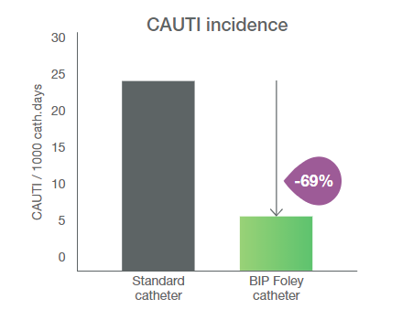
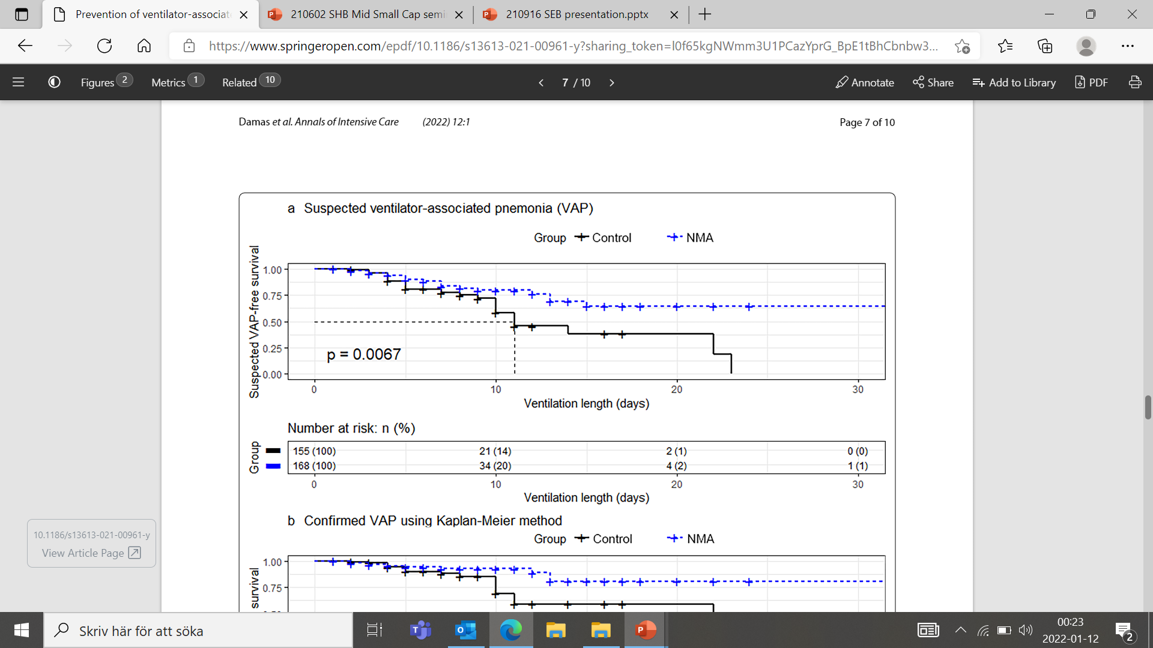


Right timing to fuel growth
Strong base and now expanded patent protection until 2039
1
2
3
Strong clinical evidence
>200 million catheters used with no reported adverse event
> 40 clinical studies incl. > 100 000 patients
Capital for growth
Strong financial foundation with > 200 mSEK in cash to fund a fact based, focused growth
Strengthened IP protection
Our IP is based on a valuable recipe, a well-kept trade secret, know-how and patents
A third generation of European patent was approved by EPO earlier this year.
The new patent is valid until 2039.
Urinary catheters
Kai-Larsen et al. 2021
Endotracheal tubes
Damas et al. 2022
-69%
-53%
Strengthening commercial and coating capabilities for continued expansion

Slide 12
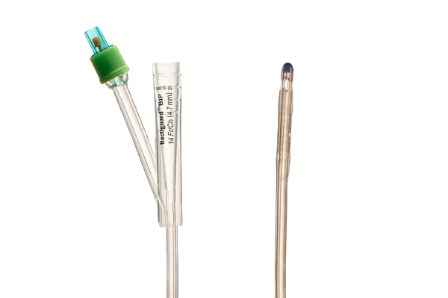
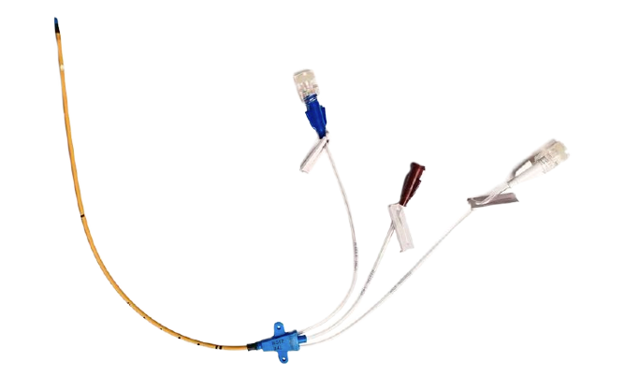
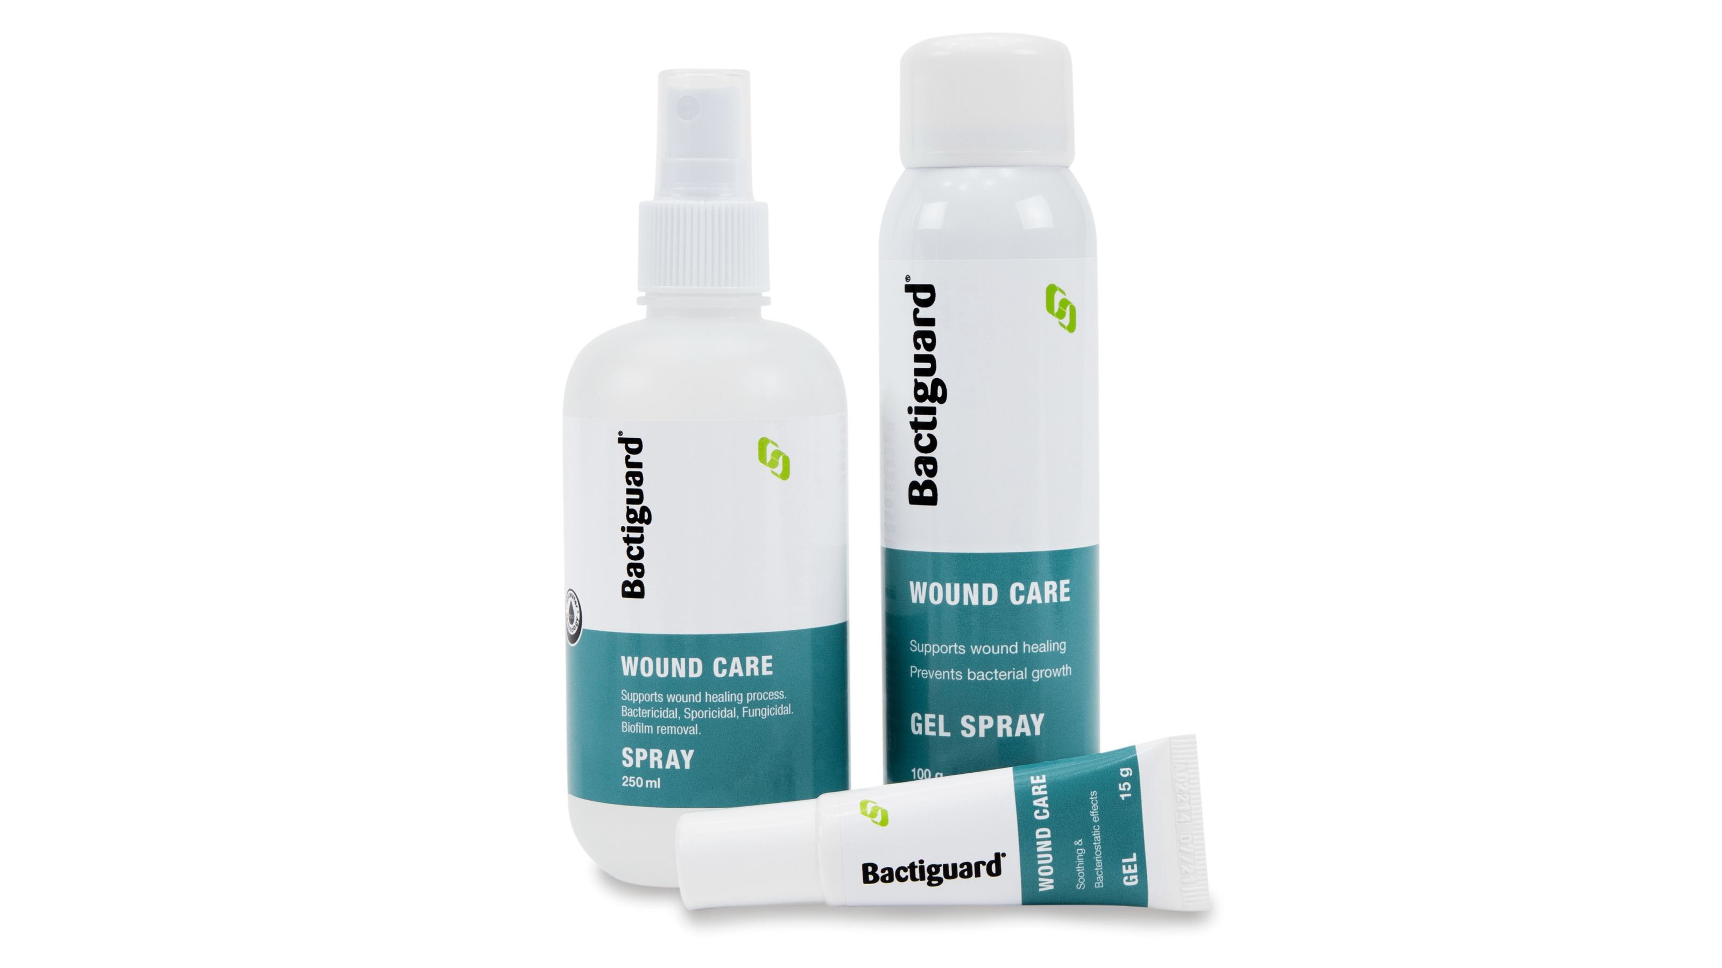





There are three key growth drivers in our fight against infections
Illustrative
Own product Portfolio
Now
Future new license customers
*
Existing license customers
* Currently a global development partnership with a license option

Slide 13





Bactiguard infection prevention – Safe and Effective
Ten reasons to invest in Bactiguard
Long-term owners and dedicated management
10
1
Contribution to the UN’s Global Sustainable Development Goal.
Scalable business model
9
2
Bactiguard technology - effective and safe
Financial Target 2026:
Revenue >1 billion SEK
EBITDA >400 million SEK
8
3
Existing license business
Clinical evidence
4
7
Major market potential
Broad product portfolio
6
5
Unique market position
Focused growth strategy
Notes:
Infection prevention more important than ever
Bactiguards unique coating has a key role to play
Strong license partners
Wound care portfolio to leverage
Strong leadership and team
Financial muscles to drive future growth
"I am proud and energized to lead Bactiguard in this exciting phase of the company's development!
We are now investing to accelerate growth and take Bactiguard to the next level!"
- Anders Göransson, CEO

Slide 14

Questions & Answers
CEO
+46 8 440 58 80
anders.goransson@bactiguard.com
Anders Göransson

Slide 15
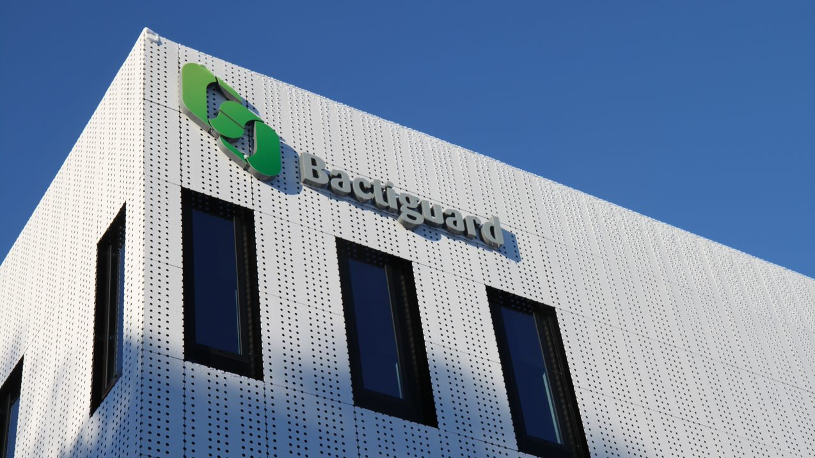
Bactiguard on the outside – safe on the inside

